Slide 1

Advancing School Safety
Amanda B. Nickerson, Ph.D., NCSP​
Professor and Director, Alberti Center for Bullying Abuse Prevention​
University at Buffalo, the State University of New York
nickersa@buffalo.edu
ed.buffalo.edu/alberti.html
@UB_BullyPrevCtr
@DrAmandaNick
Vermont Association of School Psychologists
March 19, 2019 ​

Slide 2
Learning Objectives
Identify key components of safe and successful schools
Understand the role of the multidisciplinary teams in preventing, preparing for, and responding to school crises
Describe the threat assessment process
Differentiate transient and substantive threats and their corresponding interventions

Slide 3
Overview
School safety in context
Safe and successful schools
Threat assessment: Introduction and key findings
Creating a comprehensive targeted violence prevention plan
The threat assessment process and resources
Scenarios and discussion

Slide 4
School-Associated Violent Deaths
Over the past 20 years, have school-associated violent deaths?:
Increased
Decreased
Stayed about the same

Slide 5
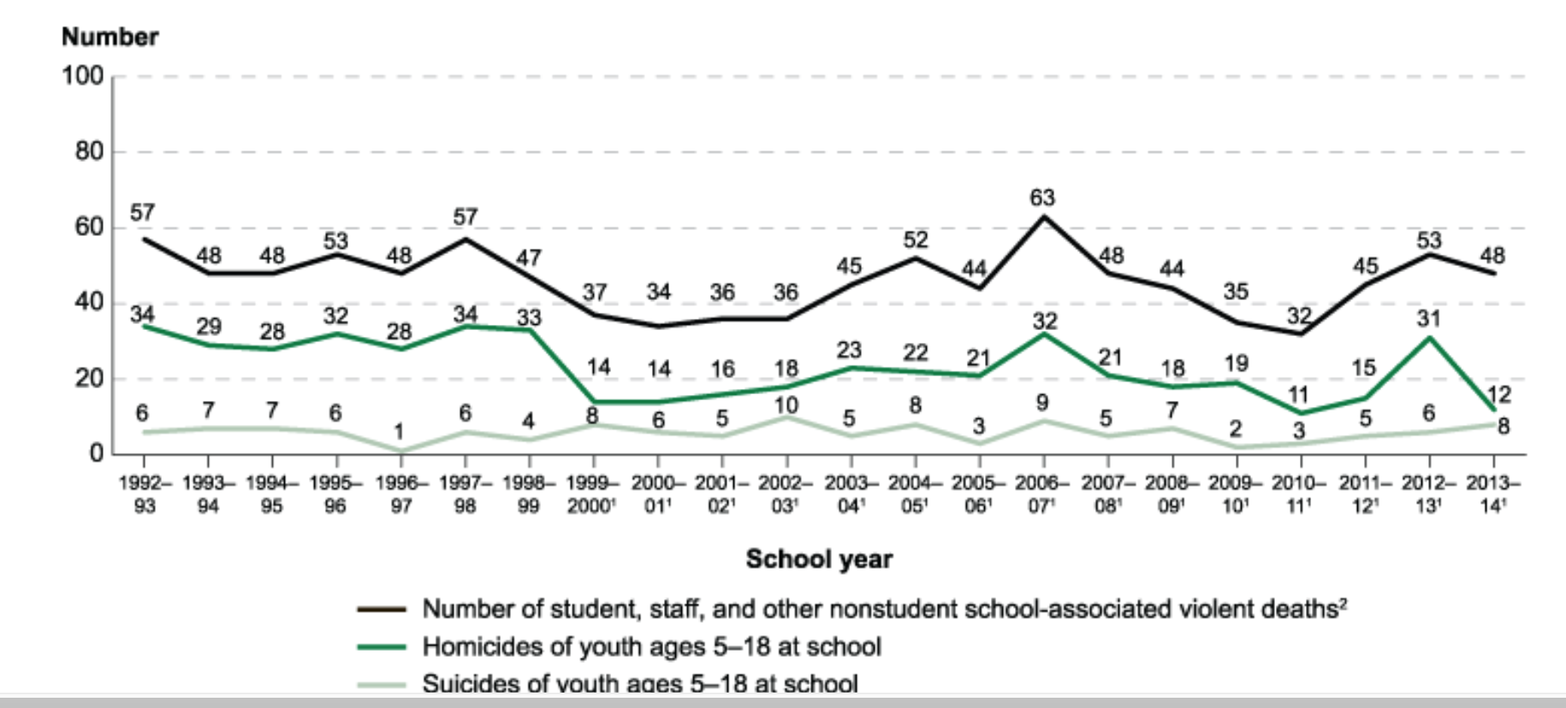
School-Associated Violent Deaths (NCES)
Notes:
Source: Robers, S., Zhang, J., and Truman, J. (2012). Indicators of School Crime and Safety: 2011 (NCES 2012-002/NCJ 236021). National Center for Education Statistics, U.S. Department of Education, and Bureau of Justice Statistics, Office of Justice Programs, U.S. Department of Justice. Washington, DC.
Notes: Data published by the National Center for Education Statistics indicate that for the 2009-2010 academic year the total U.S. student enrollment was 44,373,307 (Chen, 2011). In that year there were 17 school-associated homicides of youth ages 5 to 18 years.
Therefore, in the 2009-10 school year (the most recent year for which we have final data), the odds of a person age 5 to 18 being the victim of a homicide at school, on their way to school, or at a school sponsored event was 1 in 2.5 million (44,373,307 ÷ 17 = 2,551,371). By comparison, the odds of being struck by lightening are 1 in 700,000.
As indicated by the linear trend line for homicides in the figure, data suggest that (at least when it comes to student homicide,) schools are not only safe they are safer today than they were a decade ago. Between the academic years1992/93 to 2000/01 there were a total of 246 school associated student homicides, which is associated with a nine-year average of 27 deaths per year. By comparison, between the academic years 2001/02 to 2009/10 there were a total of 187 school associated student homicides, which is associated with a nine-year average of 21 deaths per year.

Slide 6
Youth Violent Deaths by Location
What percentage of all youth homicides and suicides occur at school, on the way to or from school, or at or on the way to school-sponsored events?
30%
20%
10%
<5%

Slide 7
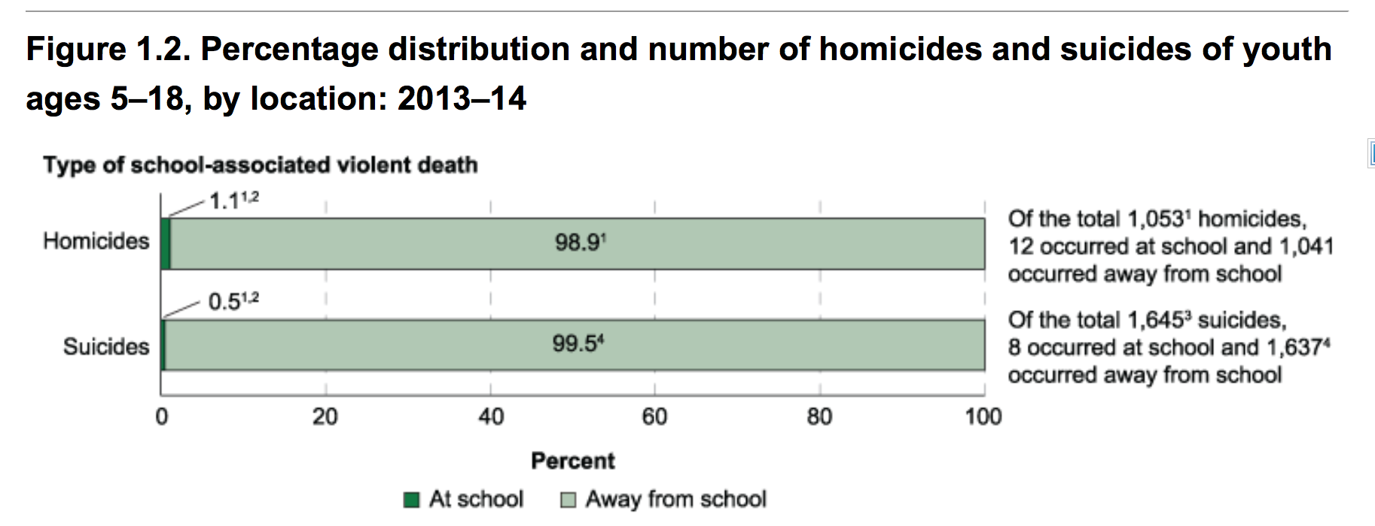
Youth Violent Deaths by Location

Slide 8
Other Threats to School Safety
Human caused, intentional
Acts of war/Terrorism
Violent/Unexpected death
Threatened death or injury
Human-caused disasters
Natural disasters
Nonfatal illness or injury
Note: Brock et al., 2016 and NASP’s PREPaRE Model
Traumatic Impact
Accidental, natural

Slide 9
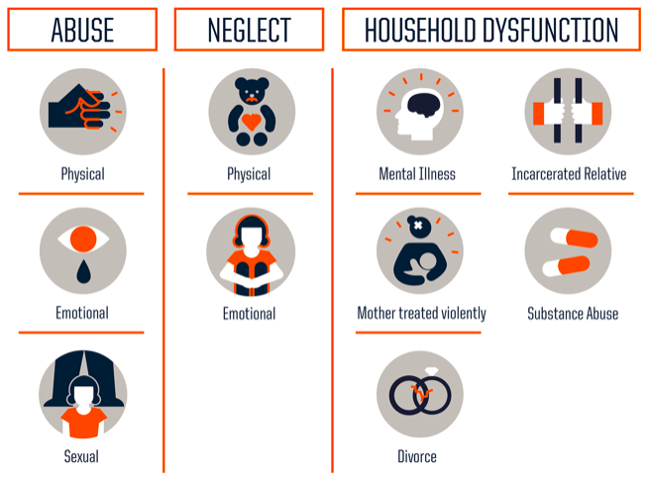
Adverse Childhood Experiences

Slide 10
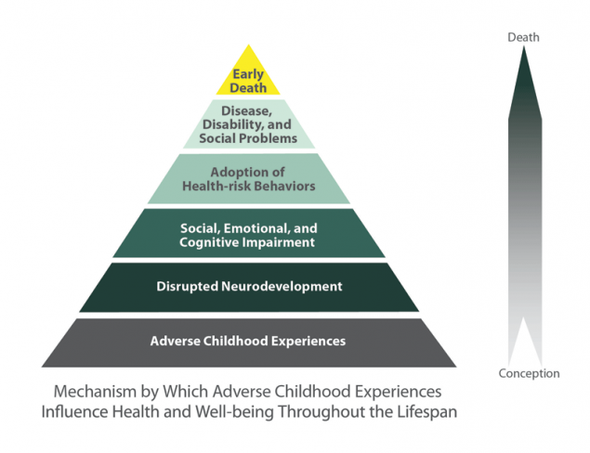
Impact of ACEs

Slide 11
Framework for Safe and Successful Schools (ASCA, NAESP, NASP, NASRO, NASSP, SSWAA)
Safe and supportive school climate
Collaboration
Multitiered Systems of Support
Integrated learning supports
Physical and psychological safety
Framework

Slide 12

School Climate: Safe? Supportive? Positive?

Slide 13
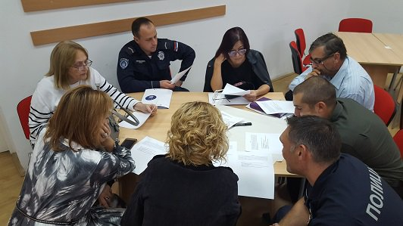
Collaboration

Slide 14
Incident Command System
Incident Commander
Public Information Officer
Operations
“Doers”
Planning “Thinkers”
Logistics
“Getters”
Safety
Officer
Liaison Officer
Mental Health Officer
Finance “Payers”

Slide 15
Tasks to Be Completed | ICS Team Member?
Inform parents about incident
Contact outside agencies for support
Help frightened students manage stress reactions
Set up reunification site, provide lunch, obtain communication supplies
Develop plan for duties in the coming days and weeks
Document expenses, file insurance claims
Public Information Officer
Liaison Officer
Operations [Mental Health]
Logistics Section Chief
Planning Section Chief
Finance Section Chief

Slide 16
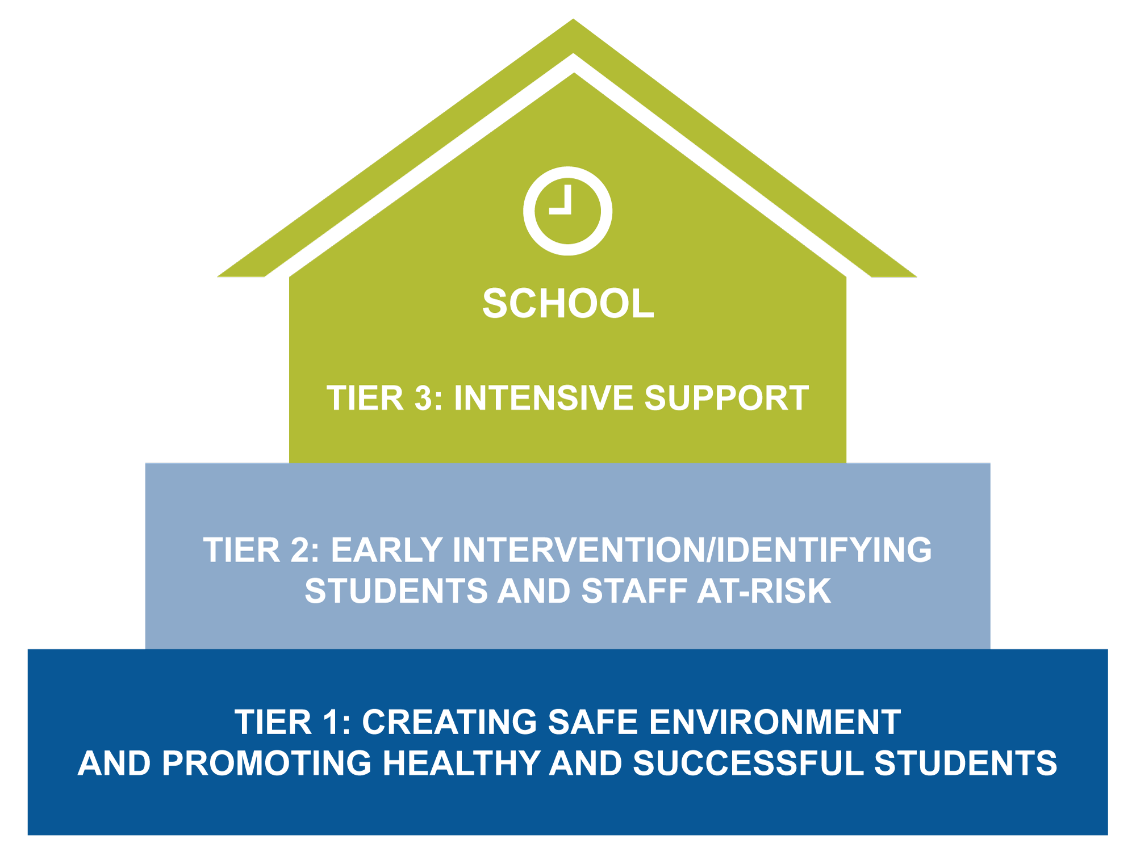
Multi-Tiered Systems of Support

Slide 17

Balance Physical and Psychological Safety
Physical safety and protection are necessary – locked doors, security, supervision/surveillance, vulnerability assessment and securing
Schools and communities cannot be fortresses
Attention to psychological safety, school climate, and connectedness is also critical
Notes:
A Sandy Hook Parent's Letter to Teachers
By Nelba Marquez-Greene
As another school year begins and old routines settle back into place, I wanted to share my story in honor of the teachers everywhere who care for our children.
I lost my 6-year-old daughter Ana Grace on Dec. 14, 2012, in the rampage at Sandy Hook Elementary School. My son, who was in the building and heard the shooting, survived.
While waiting in the firehouse that day to hear the official news that our daughter was dead, my husband and I made promises to ourselves, to each other, and to our son. We promised to face the future with courage, faith, and love. As teachers and school employees begin this new year, my wish for you is that same courage, faith, and love.
It takes guts to be a teacher. Six brave women gave their lives trying to protect their students at Sandy Hook. Other teachers were forced to run from the building, stepping over the bodies of their friends and colleagues, and they came right back to work.
When I asked my son’s teacher why she returned, she responded, “Because they are my kids. And my students need me now more than ever.” She sent daily updates on my son’s progress, from his behavior to what he’d eaten for lunch. And four months later, when my son finally smiled one day after school, I asked him about it. His response? “Mom. My teacher is so funny. I had an epic day.”
While I pray you will never find yourself in the position of the teachers at Sandy Hook, your courage will support students like my son, who have lived through traumas no child should have to.
Your courage will support students who are left out and overlooked, like the isolated young man who killed my daughter. At some point he was a young, impressionable student, often sitting all alone at school. You will have kids facing long odds for whom your smile, your encouraging word, and your willingness to go the extra mile will provide the comfort and security they need to try again tomorrow.
When you Google “hero,” there should be a picture of a principal, a school lunch worker, a custodian, a reading specialist, a teacher, or a bus monitor. Real heroes don’t wear capes. They work in America’s schools.
Being courageous requires faith. It took faith to go back to work at Sandy Hook after the shooting. Nobody had the answers or knew what would come tomorrow, but they just kept going. Every opportunity you have to create welcoming environments in our schools where parents and students feel connected counts.
Have faith that your hard work is having a profound impact on your students. Of the 15,000 personal letters I received after the shooting, only one stays at my bedside. It’s from my high school English teacher, Robert Buckley.
But you can’t be courageous or step out on faith without a deep love for what you do. Parents are sending their precious children to you this fall. Some will come fully prepared, and others not. They will come fed and with empty bellies. They will come from intact homes and fractured ones. Love them all.
When my son returned to school in January, I thought I was going to lose my mind. Imagine the difficulty in sending your surviving child into a classroom when you lost your baby in a school shooting. We sent him because we didn’t want him to be afraid. We sent him because we wanted him to understand that while our lives would never be the same, our lives still needed to move forward.
According to the 2011-12 National Survey of Children’s Health, nearly half of America’s children will have suffered at least one childhood trauma before the age of 18. They need your love.
A few weeks before the shooting, Ana Grace and I shared a special morning. Lunches were packed and clothes were picked out the night before, so we had extra time to snuggle. And while I lay in bed with my beautiful caramel princess, she sensed that I was distracted and asked, “What’s the matter, Mom?” I remember saying to her, “Nothing, baby. It’s just work.” She looked at me for a very long time with a thoughtful stare, then she told me, “Don’t let them suck your fun circuits dry, Mom.”
As you begin this school year, remember Ana Grace. Walk with courage, with faith, and with love. And don’t let them suck your fun circuits dry.

Slide 18
Create Culture of Open Communication
In 75% of school shootings, perpetrators shared plans with someone (U.S. Secret Service & U.S. Department of Education)
Most students who are bullied do not tell others
Reasons for silence include:
  Fear of retaliation
  Telling won’t help
  Don’t want to be a “snitch”
  Viewed as sign of weakness
Most school shootings that have been thwarted have been because someone has reported a concern

Slide 19
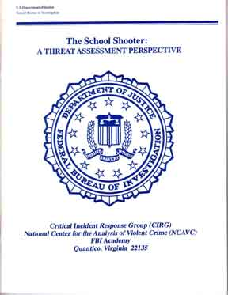
The Context of Threat Assessment
“Although the risk of an actual shooting incident at any one school is very low, threats of violence are potentially a problem at any school. Once a threat is made, having a fair, rational, and standardized method of evaluating and responding to threats is critically important.”
(O’Toole, 2000, p. 1)

Slide 20
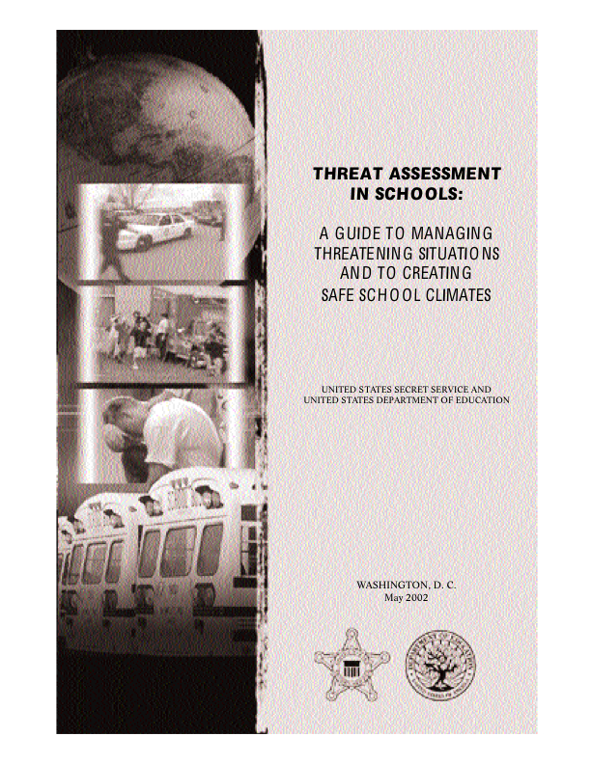
What Do We Know About School Shooters?
  U.S. Secret Service and U.S. Dept. of Education in-depth study of 37 school shootings, revealing 10 key findings
  (Fein, Vossekuil, Pollack, Borum, Modzeleski, & Reddy, 2002)

Slide 21
Finding #1:
There is no accurate “profile”
Attackers had differences in terms of:
  Family situations
  Academic achievement
  Social relationships
  Histories of disciplinary problems at school
Most attackers showed no marked change prior to attack
Over half of the attackers demonstrated some interest in violence, although most had no history of prior violent or criminal behavior
(Fein et al., 2002)
Notes:
Recommend reading Columbine by Dave Cullen
Definition of violence for this study:
Students who TARGETED an individual, several individuals, or the school itself. From these cases 10 key findings were identified.
1. Attackers ranged in age from 11 –21, with most attackers between the ages of 13 and 18.
2. Three-quarters of attackers were white.
1. Almost two-thirds of attackers came from two-parent families living either with both biological parents or with one biological parent and one stepparent.
2. Some lived with one biological parent or split time between two biological parents.
Very few attackers (5%) lived with a foster parent or legal guardian.
_______________
1. Most attackers were doing well in school at the time of the attack, generally receiving A and B grades.
2. Some were taking Advanced Placement courses and had been on the honor roll.
Very few of the attackers were known to be failing in school.
_____________
1. The largest group of attackers were considered to be mainstream students.
2. One-quarter of the attackers socialized with “fringe” group of students.
3. Few attackers had no close friends.
4. One-third of attackers had been characterized by others as “loners” or felt themselves to be loners.
Nearly half of attackers were involved in organized social activities in/out of school.
__________________________________________
1. Nearly two-thirds of attackers had never been in trouble or rarely were in trouble at school.
2. Only one-quarter of attackers had ever been suspended from school.
3. Only a few attackers had ever been expelled from school (10%).
_______________________
1. No marked change in academic performance (56%), friendship patterns (73%), interest in school (59%) and disciplinary problems (68%) prior to attack.
2. A few attackers even showed some improvements in academic performance (5%) or declines in disciplinary problems at school (7%) prior to attack.
_______________________
1. Approximately one-quarter of the attackers had exhibited an interest in violent movies (27%).
2. Approximately one-quarter of the attackers had exhibited an interest in violent books (24%).
3. One-eighth of the attackers exhibited an interest in violent video games (12%).
Many attackers exhibited an interest in violence in their own writings, such as poems, essays or journal entries (37%).
-----------------------------------------------------------------------------------------
1. Less than one-third of attackers were known to have acted violently toward others at some point prior to the incident (31%).
2. Few attackers were known to harm or kill animals (12%) prior to the incident.
Approximately one-quarter of attackers had a prior history of arrest (27%).

Slide 22

Findings #2 & #3
Finding #2: Many attackers felt bullied
  71% felt persecuted, bullied, or threatened prior to the incident
Finding #3: Losses and suicide attempts
  Most had difficulty coping with significant losses or personal failures
  78% had a history of extreme depression or desperation
  Only one-third of attackers ever received a mental health evaluation
(Fein et al., 2002)
Notes:
1. Almost three-quarters of the attackers felt persecuted, bullied, threatened, attacked or injured by others prior to the incident (71%).
2. In several cases, individual attackers had experienced bullying and harassment that was long-standing and severe.
3. In one case schoolmates described the attacker as “the kid everyone teased.”

Slide 23
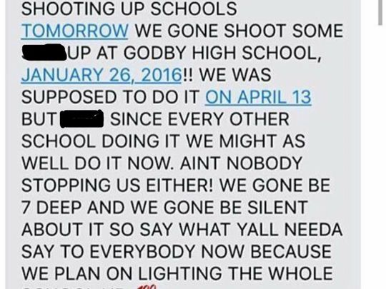
Findings #4, #5, & #6
Finding #4: Incidents of targeted violence at school rarely are sudden, impulsive acts
Finding #5: Prior to the attack, others knew about the attacker’s idea or plan to attack
Finding #6: Most attackers did not threaten their targets directly prior to the attack
(Fein et al., 2002)
Notes:
“Targeted violence” is a term developed by the Secret Service to refer to any incident of violence where a known (or knowable) attacker selects a particular target prior to their violent attack. The target may be an identified (or identifiable) person, such as a classmate, teacher. The building/school could be a target in itself.
1. In nearly all incidents the attacker had developed his idea to harm the target's) before the attack (95%)
2. The length of time that attackers held this idea prior to the actual attack varied considerably (from two days to one year).
3. Almost all of the attackers planned out the attack in advance of carrying it out (93%).
4. There was evidence from the attacker’s behavior prior to the attack that the attacker had a plan or was preparing to harm the target (93%).
5. The length of time between the planning and execution of the attacks varied (from the day of attack to 6 or 8 months before.)
_________________________________
1. Other motives include trying to solve a problem (24%); suicide or desperation (27%); and efforts to get attention or recognition (24%).
2. More than half the attackers had multiple reasons for their attacks.
3. Most attackers held some sort of grievance at the time of the attack, either against their target's) or against someone else (81%).
4. Most attackers told other people about these grievances prior to the attacks (66%).

Slide 24
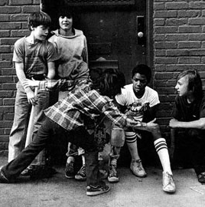
Findings #7 & #8
Finding #7: Previous behaviors caused others concern
Finding #8: In many cases, other students were involved in the attack in some capacity
(Fein et al., 2002)
Notes:
In most cases, other students were involved in some capacity, such as influencing or providing encouragement. (44%)
In 75% of the cases, other students knew about the attack before it occurred in the form of either a vague idea something big was going to happen, and often the date and time or exact details.
Peers exert enormous influence over their friends and schoolmates.
Principals, teachers, counselors, coaches, psychologists, etc, can make all the difference in preventing school violence.
Students need to know they can count on adults and won’t be considered “snitches”. This points out the need for schools to place efforts on teaching students, preferably starting at a young age, the difference between tattling (which involves telling on someone to get your own way or to get someone in trouble) and telling to keep someone from hurting themselves or others.

Slide 25
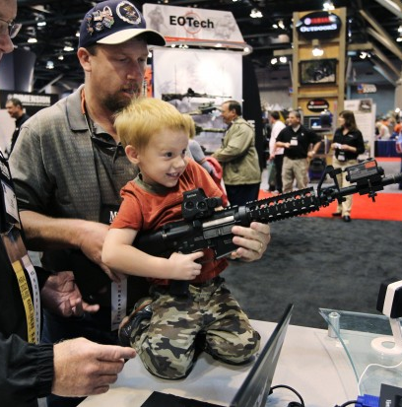
Findings #9 & #10
Finding #9: Most attackers had access to and used weapons prior to the attack
Finding #10: Most attacks were stopped by means other than law enforcement intervention
(Fein et al., 2002)
Notes:
Most attackers had previously used guns, although most did not necessarily demonstrate a“ fascination” with weapons or explosives.
1. Nearly two-thirds of the attackers had a known history of weapons use, including knives, guns and bombs (63%).
2. Over half of the attackers had some experience specifically with a gun (59%).
3. Others had experience with bombs or explosives (15%).
4. Fewer than half of the attackers demonstrated any fascination/ excessive interest with weapons and less than one-third showed a fascination with explosives (44%).
Over two-thirds of the attackers acquired the gun(s) used in their attacks from their own home or that of a relative (68%).
Most shooting incidents were not resolved by law enforcement intervention.
More than half of the attacks ended before law enforcement arrival on scene.
In these cases, staff or students stopped the attacker, the attacker stopped on his own, or he committed suicide.
Half of the incidents lasted 20 minutes or less.
Therefore, schools may make best use of their resources by focusing on prevention.
1. Only one-quarter of the incidents were stopped through law enforcement intervention (27%).
2. Close to half of the incidents were known to last 15 minutes or less.
One-quarter of the incidents were over within five minutes of their inception (27%).
TRANSITION TO NEXT SLIDE: We can use the Secret Service result to help guide us in conducting a thorough danger assessment but there are some factors we need to be aware of…..

Slide 26
What is Threat Assessment?
Process of evaluating the risk of violence posed by someone who has communicated an intent to harm
Considers the context and circumstances surrounding a threat
Includes interventions designed to manage and reduce the risk of violence
Used to uncover any evidence that indicates the threat is likely to be carried out
(Cornell & Sheras, 2006; Fein et al., 2002)
Notes:
Threat assessment is an approach to violence prevention originally developed by the U.S. Secret Service as part of its mission to protect public officials. Reports by the FBI (2000) and by the Secret Service and Department of Education (2002) recommended that schools adopt a threat assessment approach to prevent acts of targeted violence in schools. The process is centered upon analysis of facts and evidence. It focuses on actions, communications, and specific circumstances that might suggest an intent to commit a violent act.

Slide 27
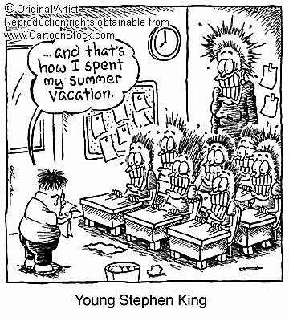
Problems with Profiling: Humor Break

Slide 28
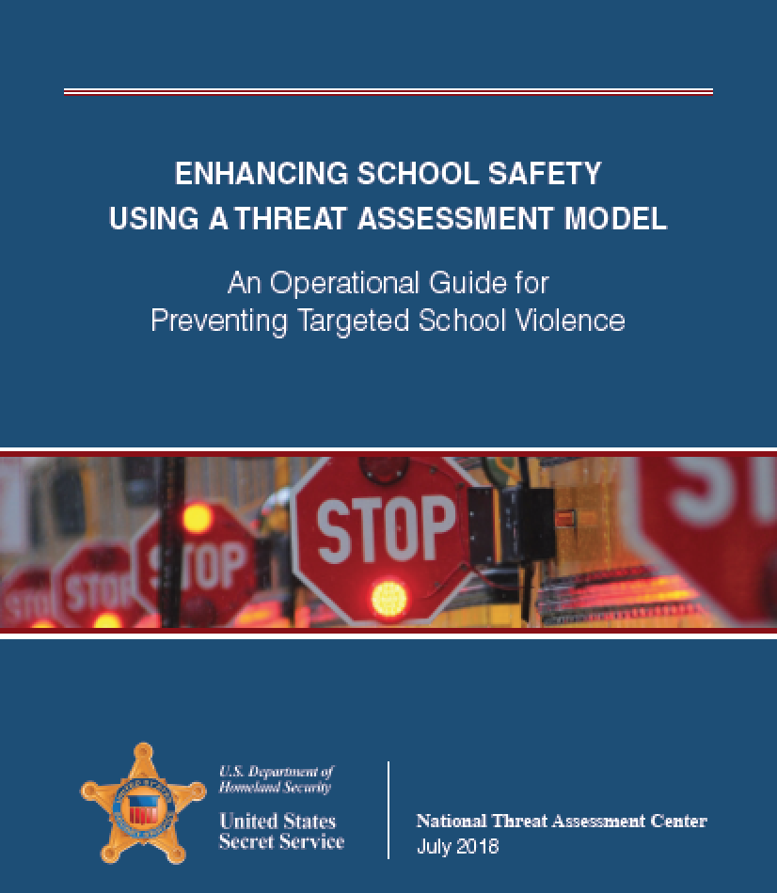
Creating a Comprehensive Targeted Violence Prevention Plan
Establish a team
Define concerning behaviors
Create reporting system
Determine threshold for law enforcement intervention
Establish threat assessment procedures
Develop risk management options
Create and promote safe school climate
Conduct trainings for all stakeholders

Slide 29
Establish a Multidisciplinary Threat Assessment Team (School and/or District Level)
Other potential members:
Teachers, coaches
Other potential names: Assessment and Care Team, Behavioral Intervention Team
Administrator
(principal or assistant principal)
School resource officer
(if available)
Mental health professionals
School psychologist to conduct assessment
School counselor or social worker to do follow-up intervention
(Cornell & Sheras, 2006)
Notes:
Threat assessment should be conducted by a multidisciplinary team that includes school administrators, school resource officers and support services staff.
Some school districts are developing a 2-tier team system. The first tier is the school based multidisciplinary team. For more complex or serious cases, the second tier, consisting of district and community personnel is utilized. Some districts have used a two tier system where the principal or designee determines if the threat is transient or substantive first, and then assembles the team.
For example in a high school setting, an assistant principal, a dean of students for discipline, a counselor, a psychologist and the school resource officer make up the school based team.
In an elementary school, the team is likely smaller. It will most likely be the principal, the psychologist or social worker, an assistant principal (if there is one), or a district consultant (special education, if needed).

Slide 30
Guiding Principles of the
Threat Assessment Process
  Targeted violence is the result of an understandable process, not a random or spontaneous act
  Consider person, situation, setting, and target
  Maintain an investigative, skeptical mindset
  Focus on facts and behaviors, not traits
  Use information from all possible sources
  Making a threat is not the same as posing a threat
  Ask “Is this student on a path toward an attack?”
(Fein et al., 2002)

Slide 31
Early Warning Signs
Stressors (risk factors)
• Significant losses and/or disappointments • Having been bullied
Symptoms (warning signs)
• Suicidal ideation and behaviors • Gun use • Interest in violence
• Hopelessness and despair • Need for revenge
These factors MAY signal that a youth has thoughts of violence
Notes:
Indicators
Which is more influential, risk factors or warning signs? Ans: warning signs
What does this list of stressors that might cause youth violence suggest in regards to youth violence PREVENTION?

Slide 32
Risk Factors for Violence
CDC (2011); Coie, Maumary-Gremaud, & Bierman (2002); Lipsey & Derzon (1998); Patterson, Reid, & Dishion (1992); Nickerson & Martens (2008)
Youth
Violence
Community
Poverty
Transiency
Low community participation
Socially disorganized neighborhood
Family disruption
Individual
History of victimization
Impulsivity/hyperactivity
Early aggressive behavior
Social information-processing deficits
Antisocial beliefs and attitudes
Drug and alcohol use
Peer/Social
Association with deviant peers
Social rejection/alienation
Low commitment to school and lack of involvement in activities
Poor academic performance
Family
Parent substance abuse or criminality
Low parent education/ income
Harsh, lax, or inconsistent discipline
Low attachment
Poor monitoring/supervision

Slide 33
Protective Factors for Violence
CDC (2011); Gregory, Cornell, Fan, Sheras, Shih, & Huang (2010); Resnick, Ireland, & Borowsky (2004)
Violence
Individual
High IQ
Intolerant attitude toward deviance
Positive social orientation
Religiosity
Family
Connectedness to family
Parent-child discussion of problems
Parental expectations for high achievement
Consistent parental presence
Frequent shared family activities
Peer/Social
Involvement in social activities
Commitment to school
School/Community
Structure (clear, consistent, strictly enforced, fair rules)
Support (teachers as caring and helpful)
Norms and climate

Slide 34
Virginia Threat Assessment Model
Model based on findings from U.S. Secret Service
Research on effectiveness
99% of threats resolved without violent incident (1 % of cases resulted in a fight or physical assault – no serious injuries
Evidence-based program listed with the Evidence-Based Practices Resource Center (formerly SAMHSA’s National Registry of Evidence-based Programs and Practices)
No racial differences in disciplinary consequences when threat assessment used
(Cornell et al., 2016; Cornell & Sheras, 2006)

Slide 35
What is a Threat?
Expression of intent to harm someone
Direct Threat
Statement of clear, explicit intent to harm
Indirect Threat
Violence is implied – threat is phrased tentatively
Conditional Threat
Made contingent on set of circumstances
Veiled Threat
Vague and subject to interpretation
Report Threats Verbatim
(Cornell & Sheras , 2006; O’Toole, 2000)

Slide 36

Example: Threat, Risks, Procedure
Roy High School example
  What was the threat?
  What specific factors indicated the level of risk?
  What was done well at Roy High School?
Path to Violence 1:20-9:20
Notes:
http://www.pbs.org/program/path-to-violence 1:20-9:20

Slide 37
Threat Assessment Process
(Cornell & Sheras, 2006)
Threat reported
Administrator evaluates threat and decides whether substantive or transient
Substantive or unclear
Serious threat of assault
- Immediate precaution to protect intended victim (notification)
- Notify student’s parents
- Apply appropriate discipline or intervention
- Consider contacting law enforcement
Very serious threat of severe injury
- All procedures for serious threat PLUS
Conduct mental health assessment of student
- Implement, monitor, and revise a written safety plan
- Maintain contact
Clearly transient threat
Reprimand
Parent contact
Mediation or counseling
Other disciplinary action

Slide 38
Evaluate the Threat
Remove student from class and supervise in a designated room
Obtain account of the threat and the context from the student and witness; background information
Write down the exact threat
Obtain student’s explanation of the threat’s meaning and his/her intentions
Obtain witness perceptions of the threat’s meaning
Notes:
The exact wording and context of a threat are very important. Interview the student who made the threat as well as witnesses. Students often leave out important contextual information when they recount an event, so be sure to ask questions to assess the situation. Observations like “he was laughing,” “joking around,” “seemed really serious,” etc. can be helpful. Also assess the witness’s motivation as a witness and his or her relationship toward the accused.

Slide 39
Sources of Information to Consider
Academic & disciplinary records (current and previous)
Law enforcement records
Search of student, backpacks, lockers, cars & home
Interviews with identified student(s), parent/guardian, school staff, targeted individual(s) of threat
Internet histories, written & artistic materials
Contact with other involved parties/agencies
Notes:
These sources of information are not necessarily in order of priority

Slide 40
Student Interview
Use professional, neutral, and non-confrontational tone
Send message that the student’s behavior has been noticed and caused concern
Give student a chance to tell his or her personal story
Provide opportunity to reassess and redirect behavior
Notes:
Primary Purpose of Student Interview is to learn about
the student’s thinking, motives, and behavior.
Watch to see if non-verbal cues match verbal communication. Does the child’s affect match the seriousness of the situation?
Warning Signs: Sees self as a victim, Displays grudges or deep resentments, Particular object of desire, Perceived injustices, humiliations, disrespect, Thoughts of death, violence, Sees no way out, Publicized acts of violence, Historically violent figures, Violent music, media, Weapons, Stalking
Mitigating Factors: stabilizing factors
Good coping skills exhibited in the past under stressful circumstances.
Have appropriate outlets for their anger- people to talk to, physical fitness regimen
Good interpersonal skills- ability to mix with others, attracts other people as friends, creates positive relationships, demonstrates patters of responsibility honoring and valuing commitment to others, involvement in extra curricular activities.
Law-abiding peers, pro-social friendships and/or healthy relationships may buffer against violence.
Willingness to share innermost thoughts with competent psychiatric/mental health professional.
Involvement in adjunct treatment- 12 step
Healthy family relationships- model effective coping, notice problems, have corrective mechanisms for aberrant behavior, set and support limits, are open-minded to new approaches, control and restrict access to weapons. (Closed family systems foster and allow problems to breed).

Slide 41
Key Questions
What are the student’s motives or goals?
Any communications of intent to attack?
Any inappropriate interest in other attacks, weapons, or mass violence?
Any attack-related behaviors? Making a plan, acquiring weapons, casing sites, etc.
Does student have capacity to attack?
Notes:
The Secret Service identified 11 questions that are often helpful in conducting a threat assessment.

Slide 42
Key Questions (cont.)
Is there hopelessness or despair?
Any trusting relationship with an adult?
Is violence regarded as a way to solve a problem? Any peer influences?
Are student’s words consistent with actions?
Are others concerned about student?
What circumstances might trigger violence?
Notes:
Note that all of the Secret Service questions are oriented around determining if the student is on a behavioral pathway leading to an act of violence. There is considerable emphasis on situational and relationship factors, and relatively little concern with personality factors or other individual characteristics that are often identified in lists of warning signs for violence.
Source: Guidelines for Responding to Student Threats of Violence, Dewey G. Cornell Ph.D. Virginia Youth Violence Project, Curry School of Education – University of Virginia. 2004 PPT.

Slide 43
Resource
Threat Assessment and Response Protocol (Thanks to Dewey Cornell and Virginia Student Threat Assessment Guidelines)
Review pages 1-6:
  Overview
  Threat report
  Interview with person who made the threat
  Interview with target or witness
  Key observations
  Observations suggesting need for intervention
Share reactions to this with small group. How does this fit in with current process?

Slide 44
Determine Level of Risk
Transient threat | Substantive threat
Passing remarks with no clear intent Vague or indirect Threat is implausible or unrealistic May be expression of temporary feelings of anger or frustration Can typically be resolved with apology or clarification | Expressed intent to physically injure someone Threat is direct, specific, or plausible Wording suggests thought to how it will be carried out Indication of time or place Statements about preparatory steps (acquiring or practicing with weapon)
When in doubt, treat as substantive and consult with team
Cornell & Sheras (2006); O’Toole (2000)

Slide 45
Communicating with Parents
Must inform parents/guardians (even if threat is transient)
Tell student first, judge their reaction
It is recommended that two school professionals (preferably in person, but on phone may be necessary) inform the parent
Stay calm
Project self-confidence (“following procedure”)
Allow parent time to ventilate (denial, guilt, blame, anger, etc.)
Help problem-solve getting help (therapists, hospitals, child welfare, police
Document phone call/meeting
Notes:
- The core of legal protection is telling the parent, in a timely fashion. Numerous legal cases. First inform the student that you will be contacting parents. In person if preferable to on the phone. Evaluate the parent’s response to the threat. If it is damaging to the child or likely to increase the probability of the violent behavior occurring, report to DHS or the local police.
- Even if feel that the threat is not serious, recommend that you still inform parent of the interview. At the same time, actively seek additional information.
- Brown vs. Milford Board of Ed, docket # 253480, New Haven, Ct, 1/87. Thirteen year old boy was upset after parents reported he forged a report card. Parents contended that school should have known he was distraught and couldn’t control his behavior and should have contacted parents at work. Friends called the police, they came and investigated, were assured he wouldn’t do it, left and boy killed himself.
- Stephen Gisel (or Eisel) v. Board of Education of Montgomery County, 1992. Determined that the duty (to prevent suicide) was breached by junior high school counselors who failed to inform a parent of suicidal statements attributed to the parent’s child by fellow students, where, when counselors sought to discuss the subject, the adolescent denied making the statements.” The court cited increased frequency of suicide.

Slide 46
Plan for Transient Threat
See that threat is resolved through explanation, apology, making amends
Provide counseling and education where appropriate
Administer discipline if appropriate
Notes:
By definition, a transient threat is not serious because it has been resolved. Nevertheless, a threat still may merit disciplinary consequences for inappropriate or disruptive behavior. A transient threat may also indicate need for supportive intervention, such as counseling, or communication with family members.

Slide 47
Plan for Serious Threat
Teach appropriate behavior and social problem-solving skills in the classroom or in a small group setting
Determine student and family needs regarding additional problems or risk factors
Make referrals to appropriate support systems
Make provisions to continue or to add to protective factors, which provide support for the at-risk student (e.g., provide adult mentor to meet with student)

Slide 48
Immediate Response for Very Serious Threat
If there are imminent warning signs, refer student for suicide and/or homicide risk assessment
Take protective action, including warning intended victims
and parents
Consult with law enforcement
Develop action plan for immediate interventions:
Increase supervision
Remove access to weapons
Initiate necessary interventions (wraparound, mental health interventions for anger/aggression)
Issue appropriate discipline (remembering that when youth are out of school they are far more likely to engage in high risk behavior and less likely to receive professional assistance)
Notes:
Determine if there are any imminent warning signs (the high risk factors discussed earlier). If there are, then refer student to the Risk Assessment Team for an immediate suicide and/or homicide risk assessment.
2. If imminent warning signs are not present, then give the student a high priority for a Student Support Meeting. Assign a Student Support Team member (e.g., principal, mental health specialist, or master teacher) to provide informal consultation until a formal meeting may be scheduled.
3. At the formal meeting, develop recommendations for responding to high-risk youth and consider the need for a referral for Special Education services.
NOT ALL OF THOSE STUDENTS WHO HAVE A RISK ASSESSMENT CONDUCTED ARE APPROPRIATE FOR SPED REFERRAL!!!
4. Consider a referral to school site mental health and community-based mental health services.

Slide 49
Very Serious Threat Intervention
Consider the need to revise student’s behavior contract and/or to conduct a more in-depth behavioral analysis
Obtain parental permission to exchange information with the appropriate community agencies to determine if student is eligible for additional service
If available, call a meeting with other agency personnel to focus on provisions for wrap-around intervention and support for the student and family
Notes:
5. Consider the need to revise student’s behavior contract and/or to conduct a more in-depth behavioral analysis.
6. Obtain parental permission to exchange information with the appropriate community agencies to determine if student is eligible for additional services. If available, call a meeting with other agency personnel to focus on provisions for wrap-around intervention and support for the student and family.
7. Develop an action plan for immediate interventions that includes provisions for increased supervision.
Note. Adapted from Dwyer and Osher

Slide 50
Resources
Threat Assessment and Response Protocol (Thanks to Dewey Cornell and Virginia Student Threat Assessment Guidelines) – p. 7 – Response to Threat (pp. 8-20 provide more detail about a mental health assessment)
Intervention and Supervision Plan (thanks to Melissa Reeves, Winthrop University; Consultant, Sigma Threat Associates)
Targeted Student Safety Plan Template (thanks to State of Washington School Safety Center)

Slide 51
Case Scenario: Marly
Scenario 1: Mrs. Jones, the ELA teacher, called the front office to report that Marly (8th grade student) picked up a pair of scissors and threatened Krista by saying, “I am sick and tired of you getting into everyone’s business and spreading rumors. The next time you try that I am going to cut you up.” Krista is a popular student who excels in school but who uses her social prestige to exclude others and gossip.
Practice with the Threat Assessment and Response Protocol:
- One person (or team of 2) is interviewer and other plays role of Marly [page 3]
- Switch roles –conduct interview with target or witness (teacher, other student) [page 4]
- Together complete threat response (p. 7) and/or other resources (supervision/intervention plan, safety plan)

Slide 52
Debrief
How did it go being the interviewer using the threat assessment protocol?
What did you determine as Marly’s level of risk and what was your rationale?
What did you do for a response?

Slide 53
Case Scenario: Jerry
Scenario 2: Two students reported to the school resource officer that Jerry said that anyone who wanted to be spared shouldn’t plan to come to school Thursday during the 9th grade assembly. The students explained that Jerry was bragging about the website he created called “Jerry’s picks,” which includes comparisons of different types of weapons, their level of destructive force, and the best uses for them (e.g., killing a single victim, destroying a group in a public place)..
Practice with the Threat Assessment and Response Protocol:
- One person (or team of 2) is interviewer and other plays role of Jerry [page 3]
- Switch roles –conduct interview with target or witness (teacher, other student) [page 4]
- Together complete threat response (p. 7) and/or other resources (supervision/intervention plan, safety plan)

Slide 54
Debrief
What did you determine as Jerry’s level of risk and what was your rationale?
What did you do for a response?

Slide 55

Questions and Thanks!
Please feel free to contact me at nickersa@buffalo.edu
ed.buffalo.edu/alberti.html
@UB_BullyPrevCtr
@DrAmandaNick

