Slide 1
Ask the Experts Webinar Series Wading through a Sea of Ambiguity: Charting a Course for Special Education Services During a Pandemic

Slide 2
“Ask the Experts” Webinar Series
Series of recorded webinars to be posted on the NASP website
Webinars are designed to offer support to school psychologists, interns, and practicum students as they navigate the delivery of school psychological services during the COVID-19 pandemic
Each webinar will be followed by the opening of a discussion thread on the NASP member community. Use the strand associated with this webinar.
Each webinar will:
Address critical questions emerging as a result of the need to provide virtual telehealth school psychological services
Provide advice and guidance from experts
Offer suggested strategies and resources for addressing professional practice issues

Slide 3
Charting a Course Given our Current Reality
It’s a Pandemic!
Prioritize care for self and others
Focus on what is reasonable & appropriate vs. compliance
This is what we know for today….more guidance to come.
NASP and our partners are here for you!

Slide 4
Quick Overview of US Dept. of Ed Guidance
Question 1: Are IEP Teams required to meet during a school closure*?
IEP Teams are not required to meet in person while schools are closed*. (OCR Fact Sheet (03/16/2020)
*Individual definitions of school closure are going to vary state to state.
Guidance from the US Dept of Education is available at www.ed.gov/coronavirus

Slide 5
Quick Overview of US Dept. of Ed Guidance
Question 2: Should we proceed with evaluations during a time of school closures?
Evaluations and re-evaluations that do not require face-to-face assessments or observations may take place while schools are closed, so long as a student’s parent or legal guardian consents. (OCR Fact Sheet - 03/16/2020)
As a general principle, during this unprecedented national emergency, public agencies are encouraged to work with parents to reach mutually agreeable extensions of time, as appropriate. (OCR/OSERS Fact Sheet- 3/21/2020)

Slide 6
Quick Overview of US Dept. of Ed Guidance
Question 3: Can we conduct IEP meetings via phone, Zoom Meeting, or some other online method?
Yes. The IDEA specifically provides that the district and the parent may agree to use alternative means of meeting participation, such as video conferences and conference calls. NOTE: Regs do not require formal consent. (34 CFR 300.328).

Slide 7
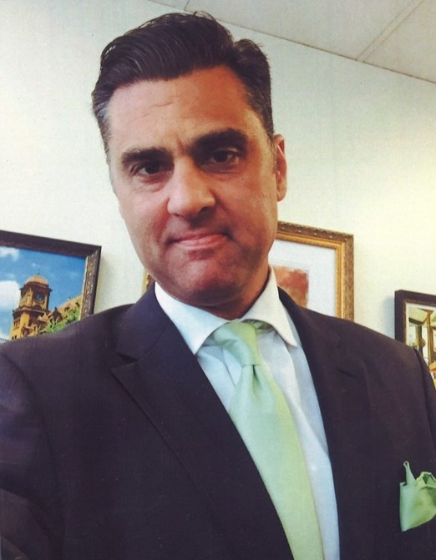
Expert Panel
NASP: Kelly Strobach, Director of Policy and Advocacy
NASDSE: John Eisenberg, Executive Director
CASE: Phyllis Wolfram, Executive Director

Slide 8
Critical Question 1:
What are you sharing with your members about how they should be providing special education and related services during the school closures?

Slide 9
Reference: Navigating the COVID-19 Crisis, CASE Webinar, 3/20/20

Slide 10
Reference: Navigating the COVID-19 Crisis, CASE Webinar, 3/20/20

Slide 11
Reference: Navigating the COVID-19 Crisis, CASE Webinar, 3/20/20

Slide 12
Critical Question 2:
What are some of the creative or adaptive ways you have heard that school psychologists are delivering services to children and their families?

Slide 13
Critical Question 3:
What are the most important considerations for school psychologists who are delivering virtual mental health or social emotional learning skills, including individual or small group counseling?

Slide 14
Critical Question 4:
What type of documentation do you think will be helpful for school psychologists to maintain at this time?

Slide 15
Question 5:
What are the most important things that special education directors (state and local) are working on right now and how can their school psychologists and state SP associations be the most helpful?

Slide 16
Key Messages
The federal government has issued guidance on how states should respond to this crisis and to the closure of schools. Read and review what it says. If you have questions, ask.
Much of this guidance permits state education agencies and local educational agencies flexibility.
Communicating with families is critical. If the families know that you are working to solve the obstacles to support their children, they will be come partners with you in this process.
Listen, Learn, Ask, Share

Slide 17
Key Messages
Reach out to your school leaders for guidance and support
Follow through and stay connected with your students and colleagues
Consider if your state school psychology association or NASP has resources that can be helpful for students, families, or educators
Help your school administrators, as appropriate, reach out to state officials for guidance through formal (direct contact by phone or email) or informal (social media) communication channels

Slide 18
NASP Resources
NASP Health Crisis Resources
https://www.nasponline.org/resources-and-publications/resources-and-podcasts/school-climate-safety-and-crisis/health-crisis-resources
NASP Virtual Service Delivery in Response to COVID-19 Disruptions
https://www.nasponline.org/resources-and-publications/resources-and-podcasts/school-climate-safety-and-crisis/health-crisis-resources/virtual-service-delivery-in-response-to-covid-19-disruptions
NASP Guidance for the Delivery of School Psychological Telehealth Services
http://www.nasponline.org/assets/documents/Guidance_Telehealth_Virtual_Service_%20Delivery_Final%20(2).pdf
NASP Summary of DoE Q&A
https://www.nasponline.org/resources-and-publications/resources-and-podcasts/school-climate-safety-and-crisis/health-crisis-resources/usdoe-guidance-for-idea-service-delivery-faq-for-school-psychologists

Slide 19
NASP Resources
Just a Click Away: Virtual School Psychologist for Hire
https://www.nasponline.org/publications/periodicals/communique/issues/volume-46-issue-1/just-a-click-away-virtual-school-psychologist-for-hire
NASP Special Education resources:
https://www.nasponline.org/resources-and-publications/resources-and-podcasts/special-education
NASP Policy and Practice Recommendations for SLD Eligibility:
https://www.nasponline.org/resources-and-publications/resources-and-podcasts/special-education/sld-eligibility-policy-and-practice-reccomendations
NASP Handouts for Special Education
https://www.nasponline.org/resources-and-publications/families-and-educators

Slide 20
External Resources
US Department of Education Resources: www.ed.gov/coronavirus
US DoE OCR Fact Sheet for addressing COVID-19 in schools:
https://www2.ed.gov/about/offices/list/ocr/docs/ocr-coronavirus-fact-sheet.pdf
US DoE OCR webinar on online education and website accessibility:
https://www.youtube.com/watch? v=DCMLk4cES6A
NCSECS COVID-19 and students with disabilities:
https://www.ncsecs.org/wp-content/uploads/COVID-19-and-Students-with-Disabilities-.pdf
COPAA statement on students’ rights under IDEA during COVID-19 outbreak:
https://www.copaa.org/news/493349/COPAA-Statement-on-Student-Rights-Under-IDEA-During-the-COVID-19-Outbreak.htm

Slide 21
External Resources
US Department of Education, FERPA and COVID 19
https://studentprivacy.ed.gov/resources/ferpa-and-coronavirus-disease-2019-covid-19
US Department of Education, FERPA and Virtual Learning
https://studentprivacy.ed.gov/resources/ferpa-and-virtual-learning
Health Exception Disclosures
https://studentprivacy.ed.gov/faq/when-it-permissible-utilize-ferpa%E2%80%99s-health-or-safety-emergency-exception-disclosures
CASE Considerations for Special Education Administrators:
https://docs.google.com/document/d/1zEH-ggcHSI7sRQy5IpPEC0FaP4Vw5Wm0uUooruNFmrI/edit

