Slide 1
Developing as an agent of social justice
David Shriberg
@DrDaveShriberg
Loyola University Chicago
@ 2018, Vermont Association of School Psychologists

Slide 2
What Am I in For? A Roadmap
Presentation Objectives
Introduction
Foundations
  What Is Social Justice?
Applications
  Frameworks for Action
  Creating a Personal Action Plan

Slide 3
Presentation Objectives
Enhanced understanding of core multicultural and social justice frameworks
Enhanced ability to apply social justice frameworks to your practice

Slide 4
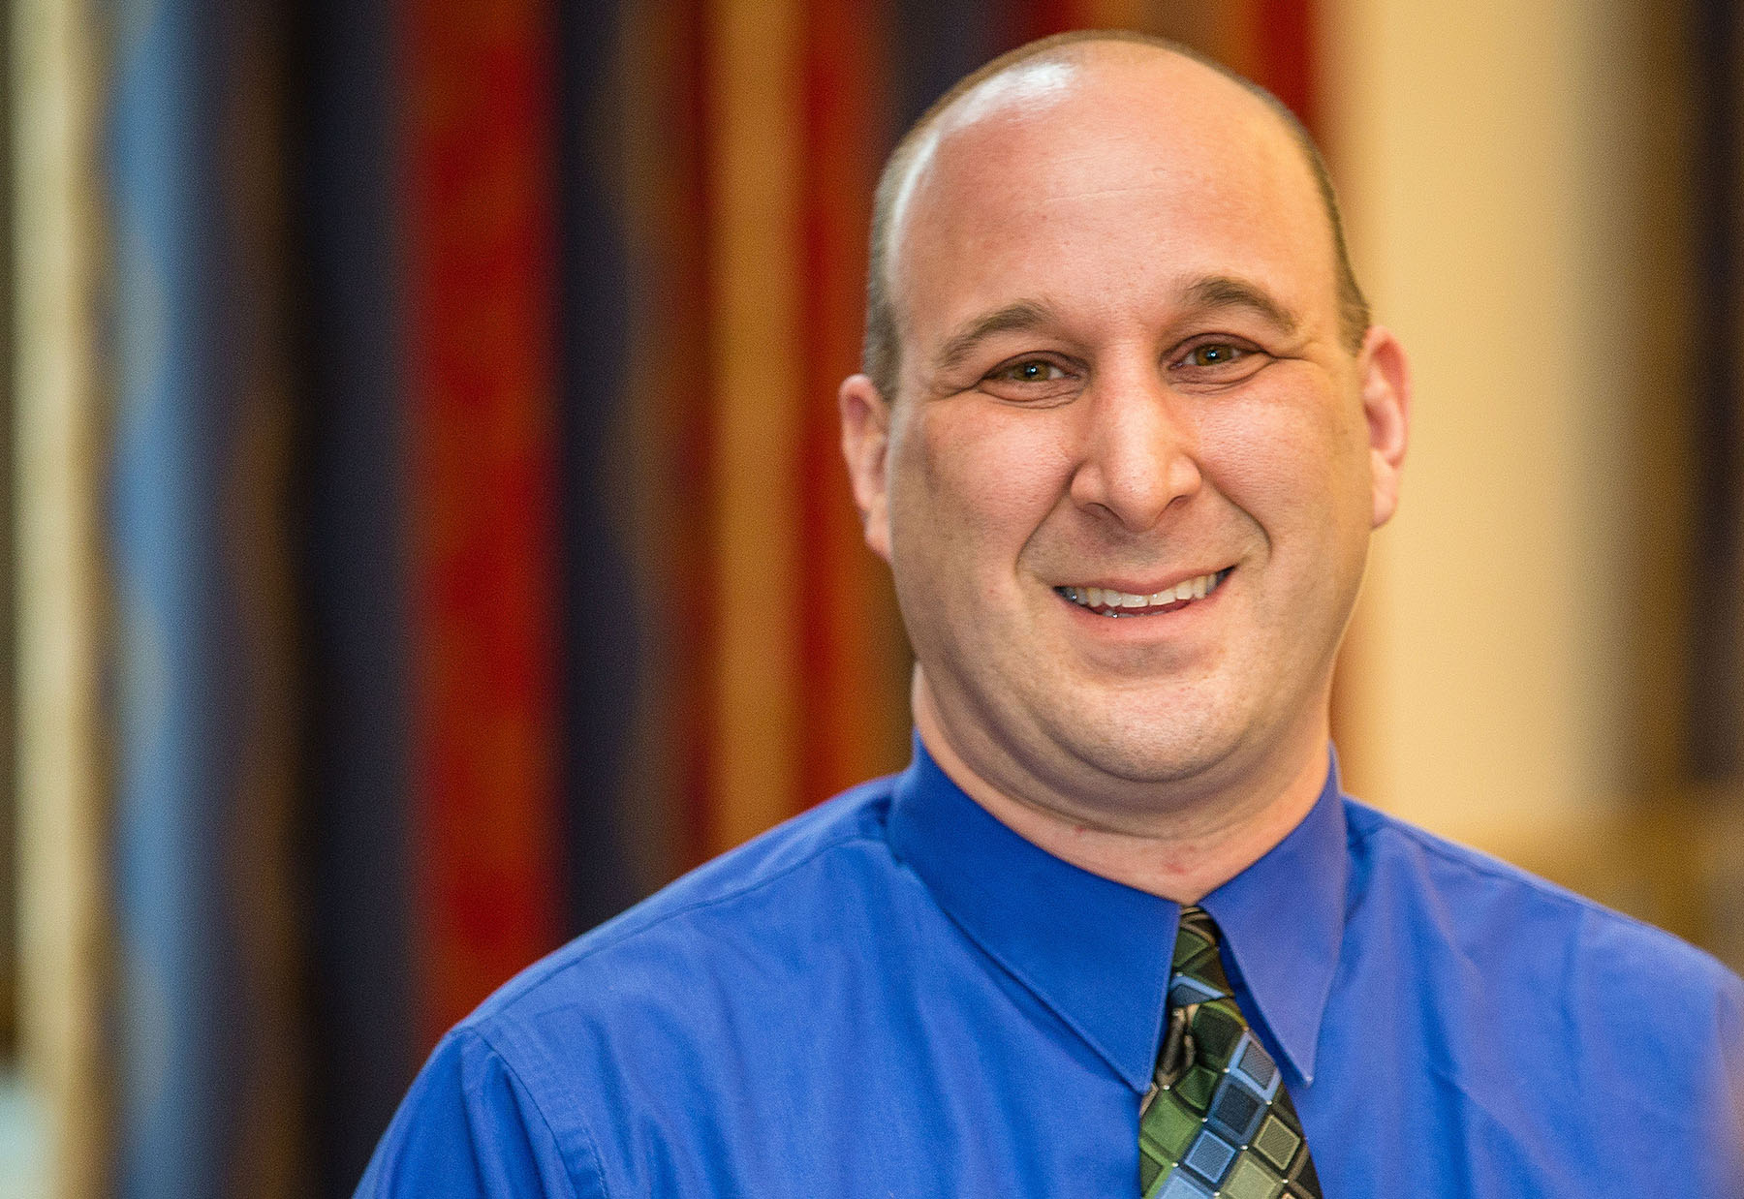
My background……
Notes:
Child of 1960s activists, how I found school psychology, practitioner background, professor, research in sj

Slide 5
About Me
Personal experience/upbringing
Student and practitioner days: eyes opening to privilege in all forms (e.g., white privilege) and to injustices experienced by kids in schools
Move to professor: broader vantage point, access to the next generation, more focused mission related to school psychology and social justice (e.g., writings and presenting on social justice, member of National Association of School Psychologists Social Justice Task Force)
Current status: Role as a white cisgender male professor related to social justice research and advocacy; feel sense of urgency nationally and need to keep growing personally and professionally

Slide 6
FOUNDATIONS

Slide 7
Opening Pairs Activity
How would you define social justice?
How would you differentiate social justice from “best practice” in education?
Should educators be concerned with social justice issues and advocacy? Why or why not?

Slide 8
What is the most socially just way to divide this…?

Slide 9
What is This Thing Called Social Justice? Definitions

Slide 10
Social Justice Definition for School Psychologists
Social justice is both a process and a goal that requires action. School psychologists work to ensure the protection of the educational rights, opportunities, and well-being of all children, especially those whose voices have been muted, identities obscured, or needs obscured. Social justice requires promoting non-discriminatory practices and the empowerment of families and communities. School psychologists enact social justice through culturally-responsive professional practice and advocacy to create schools, communities, and systems that ensure equity and fairness for all children.
Adopted by the NASP Board of Directors, April 2017.

Slide 11
Sub-Categories: Meta-Themes About Defining Social Justice in School Psychology
Comes from three studies of practitioners, one study of multicultural experts in school psychology, and two studies of school psychology graduate students
Recurring themes of access to resources, treating students equitably and respectfully, engaging in culturally responsive practice, and taking personal responsibility (often through advocacy)

Slide 12
Diaz (2014)- Forms of Social Justice
Distributive justice: how are resources allocated in society?
  Example: school funding
Procedural justice: the process through which decisions are made
  Example: special education procedures
Relational justice: how are people being treated?
  Examples: tolerance of homophobic bullying, racial prejudice in school discipline practices

Slide 13
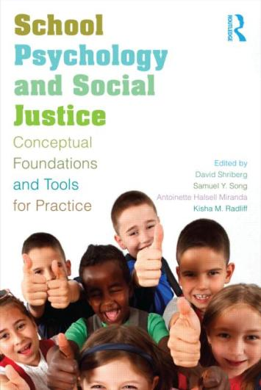
Shriberg, Song, Miranda, & Radliff, 2013

Slide 14
Shriberg, Song, Miranda, & Radliff, 2013
Vision for what society can/should look like
Mindset: the “goggles” we wear when we examine practice, research, ethical issues in field
Skillset: commitment to advocacy, the ability both to support justice and to be a “constructive irritant” when it comes to injustice
Notes:
Insert picture of book here

Slide 15
Social Justice Comes From a Multicultural Framework
Self-awareness
Awareness of others/surrounding environment
Translation to action

Slide 16
Social Justice as an Outgrowth of Multiculturalism
Acceptance of Multiculturalism as a Legitimate Topic
Field Develops Multicultural Competencies
Field Moves Towards Social Justice Orientation and Action Steps

Slide 17
Example of Social Justice Orientation
Overrepresentation of students who are ELL in requests for cognitive evaluation
Can work with each student in a “culturally competent” way, but if do not question high referral rate, status quo/disproportionality continues

Slide 18
Oppression: An Overarching Concept
Classism
Sexism
Religious Oppression
Ageism/Adultism
Heterosexism
Racism
Transgender Oppression
Ableism
Anti-Semitism
With Many Different Manifestations
18
© Taylor & Francis 2015

Slide 19
Levels of Oppression
Individual: Acts of prejudice, ignorance, hatred (intentional and unintentional)
Institutional: Policy, practice, norms (intentional and unintentional)
Cultural and Societal: Assumptions, norms, practices (intentional and unintentional)
19
© Taylor & Francis 2015

Slide 20
Oppression Results In
Disadvantages for Subordinated Groups
+
Advantages for Privileged Groups
Privilege = Unearned, unasked for, often invisible benefits and advantages not available to members of subordinated groups
20
© Taylor & Francis 2015

Slide 21
Getting Started: Broad Concepts

Slide 22
Challenging Our Socialization =
Challenging Our Comfort Zones
Action
Learning Edge
Threat
Fear
Comfort Zone
Status Quo
Information
Awareness
Learning Edge
22
© Taylor & Francis 2015

Slide 23
Spheres of Influence
Self: Educating yourself, understanding your values and feelings, examining how you want to change
Close family and friends: Influencing the people closest to you
Social, school, and work relationships: Friends and acquaintances, co-workers, neighbors, classmates, people with whom you interact on a regular basis
Community: People with whom you interact infrequently or in community settings
Social, school, and work relationships
Close family and friends
Self
Community
Source: M. Adams, L. A. Bell, & P. Griffin (2007). Teaching for Diversity and Social Justice (2nd ed.). New York: Routledge.
23
© Taylor & Francis 2015

Slide 24
Action Steps: Practitioner Interviews (Jones, Shriberg, et al, in press)
Starts with taking personal responsibility
Being politically savvy
Modeling the change you are seeking to bring about
Being culturally responsive

Slide 25
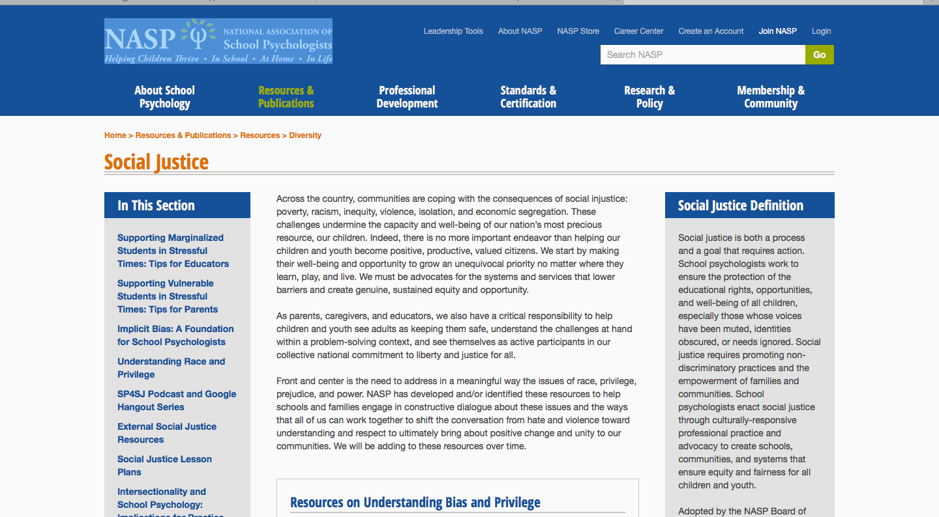
NASP Social Justice Resources

Slide 26
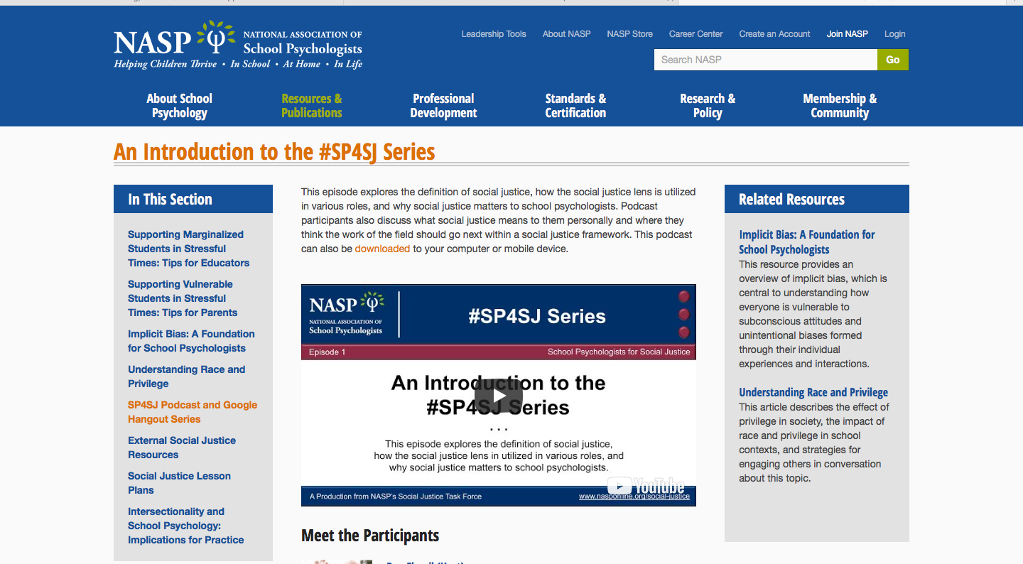
#SP4SJ Podcast

Slide 27
Five Step Process to Developing as an Agent of Social Justice

Slide 28
Initiating Change as an Agent of Social Justice: Five Key Action Steps
Self-Examination
Step #1: Who are you?
Self within System
Step #2: Awareness of context- what single stories are being told?
Step #3: What are your leverage points within the system?
Step #4: Who are your allies?
Step #5: How can you facilitate getting ideas/projects off the ground?
  Philosophical framework: Participatory approaches

Slide 29
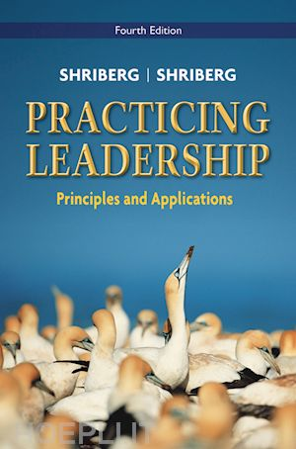
Self-Awareness: The Role of Leadership

Slide 30
Step #1: Self-Awareness
What social change/social justice topics give you the most “spittle”?
WHY do these topics matter to you?
What are my personal leadership and cultural strengths?
What are my personal leadership and cultural gaps?
Where can I make the biggest potential positive impact?

Slide 31
Peak Performance
Describe a time that you were performing at your peak:
1) What did this feel like physically and psychologically?
2) What were the precursors?
3) What were the outcomes?
4) What lessons from this experience, if any, might be incorporated into your practice?

Slide 32
IMPLICIT BIAS

Slide 33
Dual System Theory
System 1:
  Unconscious processing
  Automatic
  Extremely Fast
System 2:
  Conscious processing
  Requires concentration
  Effortful, deliberate
Systems work together to make sense of the world

Slide 34
Implicit Bias
Attitudes or stereotypes that affect our understanding, actions, and decisions in an unconscious manner
Activated by identities we perceive in others:
  Race, ethnicity, gender, age, religion, weight, sexuality, disability, etc.
Automatically associate characteristics with stereotypes
May not align with explicit beliefs

Slide 35
Implicit Bias in Education
Non-black teachers of Black students demonstrated significantly lower expectations than black teachers (Gershenson, Holt, & Papageorge, 2015)
Pre-service teachers held negative/neutral attitudes toward racial minority students (Glock & Karback, 2015)
Teacher rated Black students who showed more imaginative play as less well-adjusted compared to non-Black children (Yates & Marcelo, 2014)
Early educators were more likely to expect Black boys to misbehave than White boys (Gilliam et al., 2016)

Slide 36
Implicit Bias and Special Education
Students with disabilities are more than 2x as likely to receive out-of-school suspensions (CRDC, 2014)
Black students over-represented in SpEd Emotional Disability and Intellectual Disability categories but under-represented in Autism category (The Equity Project, 2015)
Latino students under-represented in SpEd in childhood but over-represented in high school (The Equity Project, 2015)
Symptomatology of autism may predispose individuals to activate negative implicit biases (Yull, 2015)

Slide 37
More on Implicit Bias
Handout in November 2017 of Communiqué
Implicit.harvard.edu

Slide 38
Step 2: Awareness of System- The Danger of a Single Story
http://www.ted.com/talks/chimamanda_adichie_the_danger_of_a_single_story

Slide 39
Single Story Discussion
What “single stories” are commonly told in schools?
What are some single stories that educators can work against?

Slide 40
Step #3:What are your leverage points?
School psychology training + access
Do I have any power or influence?

Slide 41
Sources of Power- French & Raven (within school psychology, see Erchul)
Power
Expert Power
Referent Power
Legitimate Power
Informational Power
Reward or
Coercive Power

Slide 42
Sources of power (French and Raven, 1962)
Expert power: based on presumption of knowledge (Is there a doctor in the house?)
Informational power: based on the power of your argument (e.g., being the person in the room who knows the law)
Referent power: based on relationship and personal drawing power (e.g, charismatic or moral leadership)
Legitimate power: bestowed by the formal organization (e.g., the power to have the final say in a decision)
Reward/Coercive power: ability to provide incentives and/or punish through praise, threats

Slide 43
Step #4: Who Are Your Allies?
Not always found in traditional places and not always found among the “professionals” or within school walls

Slide 44
Step #5: Getting Ideas/Projects off the Ground
Philosophical Framework: Grounded in Participatory Approaches

Slide 45
What do I mean by participatory approaches?
Central premise: those affected by any proposed actions should have a real say in the development, implementation, and assessment of these actions

Slide 46
How to Design and Implement the PAR Process: (Stringer, 2014)
Setting the Stage: Planning a research process (building relationships, laying the groundwork for action)
Look: Gathering Data
Think: Reflection and Analysis- what does your data indicate?
Act: Action Plans- Implementing Sustainable Solutions

Slide 47
Using a PAR Process to Combat Bullying: A Case Example

Slide 48
Defining Bullying: Three Key Elements
The victim must experience intentional (vs. accidental) negative actions, including physical (hitting), verbal (name calling), and/or indirect forms of aggressive behaviors (e.g., rumor spreading, purposeful isolation and exclusion, cyberbullying).
The victim must be exposed to these negative actions repeatedly and have trouble defending him or herself.
The bully is in a more powerful position relative to the child targeted for aggression (Olweus, 1993).

Slide 49
Our starting point
Middle school was engaged in many anti-bullying efforts
  The Bully Hotline
  The Peace Summit
  Be a Buddy Not a Bully slogan
  The Intervention Room
  Student Advisory
  Anti-bullying skits
School leadership wanted to develop a better understanding of which efforts were most effective.

Slide 50
Project Team Plans and Parameters
Started by bringing multidisciplinary group together and discussing shared vision and goals
The initial goal was along the lines of the maxim to work smarter, not harder.
Structural agreement
  Monthly
  Clear goals
  Task-oriented
  More ownership/responsibility on part of school as time progressed: do not want to become dependent on Loyola or a grant for work to continue

Slide 51
Our Process: Social Justice Framework
Relational Justice:
  Child Rights perspective: students have a right to have input into what is happening to them in school and to be able to go to school without being bullied or witnessing bullying. Bullying harms all involved.
Procedural Justice:
  Is bullying being handled consistently and fairly by teachers and school administrators?
  Is our data collection process respectful to all involved and all that would be impacted by any proposed changes?

Slide 52
Project Steps
Fall Year 1
Spring Year 1
Meet with co-principals, establish project goals, create research team (Setting the Stage)
Educator and student interviews and student survey data collected and analyzed (Look, Think)
Implementation of changed practices (i.e., streamlined system for responding to bullying & coordinating anti-bullying efforts) based on Spring data (Setting the Stage, Act)
Teacher interviews and survey, student survey (attempted student interviews) (Look, Think)
Year 2
End of Year 2/Start of Year 3
(Shriberg, Burns, Desai, Grunewald, & Pitts, 2015)

Slide 53
Spring of Year 3: Creation of Student Leadership Groups
7th graders nominated by teachers as kids not believed to be involved in bullying and either already are leaders or have strong leadership potential
10 week group co-led by myself and four Loyola school psychology graduate students
Group thematic areas: leadership development/team building, bullying 101 education, training on the problem solving model, development of action strategies to combat bullying
Outcomes: student/educator dialogues; changes in adult supervision patterns (especially in locker rooms)
    Shriberg, Brooks, Jenkins, Immen, Sutter, & Cronin, 2017

Slide 54
Final Activity: Moving Forward on Your Social Justice Action Plan

Slide 55
Some Closing Thoughts on Leading for Social Justice (Shriberg, 2009)
1. Critically examine your own definition of “socially just practice” and the degree to which your professional work supports (or perhaps works against) this aspiration.
2. Listen closely to and seek to draw out the voices of those with less power, particularly students and families.
3. Examine reports of student “misbehavior“ or “disability” critically. Is a single story happening? When you feel that individuals are being singled out for blame and/or pathology without a concomitant examination of the role of social, political, financial, legal, and/or educational structures in creating this“problem”,reframe the narrative to present a more just picture.

Slide 56
Closing Thoughts: Continued
4. Choose your battles, playing to your personal passions and the needs that you see. When taking on a social justice challenge, think big but start small, focusing on short-term goals and plans that are both achievable and, if met, can serve as springboards to larger action.
5. Collaborate, collaborate, collaborate, including reaching out to students, families, communities, school leaders, and other educators and also including networking with other professionals who share a commitment to social justice. Very few, if any, social justice challenges can or should be solved by one individual.

Slide 57
What Can We Do? (Johnson, 2013)
Little risks: Do something- “You can subvert the assumption that everyone’s going along with the status quo but simple not going along. When you do this, you stop the flow, if only for a moment, but in that moment other people can notice and start to think and question” (p.613)

Slide 58
For more information, please contact David Shriberg at drdaveshriberg@gmail.com And please follow me at @dRDAVESHRIBERG
THANK YOU!!!

